Slide 1
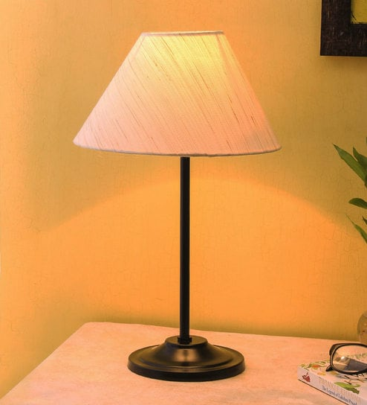
WELCOME
Mobile And Application Development

Slide 2

SharedPrefrences in Android
Mobile And Application Development
Practical
Instructor: Muhammad Naeem Khan

Slide 3
What is Shared-Prefrence?
One of the way to store data in Android.
It saves and retrieves data in the form of key and value pair.

Slide 4
Methods of shared-prefrence class
S.No | Method and Description
1 | apply() It is an abstrict method. It will commit your changes back from editor to the sharedPrefrence object you are calling.
2 | clear() It will remove all values from editor.
3 | remove(String key) It will remove the value whose key has been pass a parameter.
4 | putString(String key, String value) It will save a string value in a preference editor.
5 | putInt(String key, int value) It will save an integer value in a preference editor.
6 | putLong(String key, long value) It will save a long value in a preference editor.
7 | putFloat(String key, float value) It will save a float value in a preference editor.

Slide 5
Activity_main
activity_main.xml | Mainactivity.java
<LinearLayout android:layout_height = “match_parent” android:layout_width = “match_parent” Android:background = “color”> <TextView android:layout_height = “wrap_content” android:layout_width = “wrap_content” android:text = “Superior College Mian Channu” /LinearLayout> | new Handler().postDelayed(new Runnable()) { SharedPrefrences pref = getSharedPrefrences(name:”login”, MODE_PRIVATE); Boolean check = pref.getBoolean(“flag”,false); Intent iNext; if(check){ //for ture (user is logged In) iNext = new Intent(Mainactivity.this,HomeActivity.class); } else{ //for false(either first time or user is logged out) iNext = new Intent(Mainactivity.this,LoginActivity.class); } startActivity(iNext); }, delayMilis: 4000);}

Slide 6
LoginActivity
activity_login.xml | LoginActivity.Java
<LinearLayout android:layout_height = “match_parent” android:layout_width = “match_parent” Android:background = “color”> <Button android:layout_height = “wrap_content” android:layout_width = “wrap_content” android:text = “Login” Id = “btnLogin” /LinearLayout> | Button btnLogin btnLogin = findViewById(R.id. btnLogin); btnLogin.setOnClickListener(new View.onClickListener){ // code for verfication SharedPrefrences pref = getSharedPrefrences(name:”login”, MODE_PRIVATE); SharedPrefrences .Editor editor = pref.edit(); editor .putBoolean(“flag”,true); Editor.apply(); Intent iHome = new Intent(LoginActivity.this,HomeActivity.class); startActivity(iHome); }

Slide 7
HomeActivity
activity_home.xml | HomeActivity.Java Code
<LinearLayout android:layout_height = “match_parent” android:layout_width = “match_parent” Android:background = “color”> <Button android:layout_height = “wrap_content” android:layout_width = “wrap_content” android:text = “Logout” Id = “btnLogout” /LinearLayout> | Button btnLogout btnLogout = findViewById(R.id. btnLogout); btnLogin.setOnClickListener(new View.onClickListener){ SharedPrefrences pref = getSharedPrefrences(name:”login”, MODE_PRIVATE); SharedPrefrences .Editor editor = pref.edit(); editor .putBoolean(“flag”,false); editor.apply();

Slide 8
Thank You

